Slide 1

Central Processing Unit
Presented By:
Elizer Ponio Jr.

Slide 2
Central Processing Unit
What is a CPU?
What are CPU Cores?
What are CPU Threads?
What is a CPU Clock Speed?
What is CPU Cache?
Picking the right CPU for your computer.

Slide 3
What is a CPU?
The electronic circuitry within a computer that carries out the instruction of a computer program by performing the basic arithmetic, logical, control and input/output (I/O) operations specified by the instructions.

Slide 4
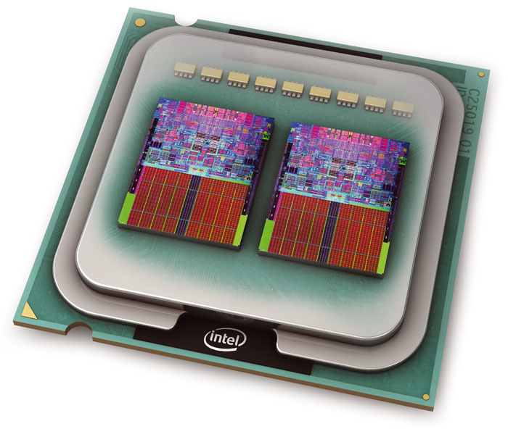
What are CPU Cores?
The amount of “CPUs” on a CPU.

Slide 5
What are CPU Cores?
Before multi-core processors became widely used, motherboard manufacturers used to add multiple sockets for additional CPUs to add performance.
This became too expensive to manufacture.

Slide 6
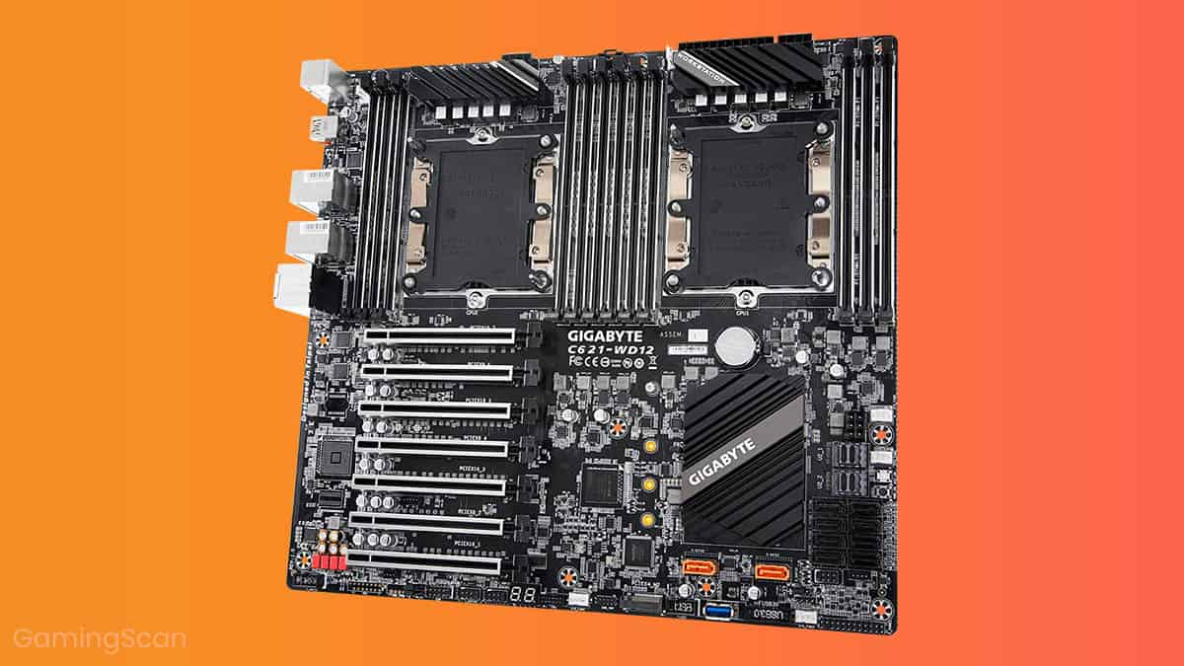
What are CPU Cores?

Slide 7
What are CPU Cores?
With multi-core processors, instructions/tasks can be split between the cores and execute them simultaneously.
Each core in a multi-core processor has a clock speed attributed to the CPU.

Slide 8
What are CPU Threads?
They are basically a virtual version of a CPU core.
Allows a CPU core to switch to multiple tasks (multitasking).

Slide 9
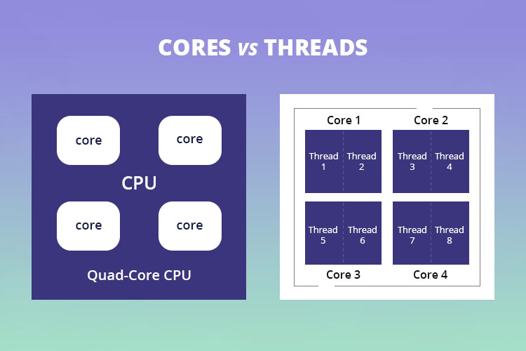
Cores vs Threads

Slide 10
Cores vs Threads
(4 Physical Cores ) * ( 1 Thread per core) = 4 Logical Cores
(4 Physical Cores ) * ( 2 Thread per core) = 8 Logical Cores

Slide 11
More threads, faster?
Not necessarily, it depends on the application you are using.
Some applications utilize multiple cores and threads available on a CPU while others do not.

Slide 12
What is a CPU Clock Speed?
Clock speed is the rate a processor can complete a cycle.
During each cycle, billions of transistors within the processor open and close.
A CPU with a clock speed of 3.2 GHz executes 3.2 billions cycles per second. (Older CPUs had speeds measured in MHz, or millions of cycles per second).

Slide 13
Clock Cycle
Sometimes, multiple instructions are completed in a single clock cycle.
In other cases, one instruction might be handled over multiple clock cycle
Since different CPU designs handle instructions differently, it’s best to compare clock speeds within the same CPU brand and generation.
.
Notes:
For example, a CPU with a higher clock speed from five years ago might be outperformed by a new CPU with a lower clock speed, as the newer architecture deals with instructions more efficiently. An X-series Intel® processor might outperform a K-series processor with a higher clock speed, because it splits tasks between more cores and features a larger CPU cache. But within the same generation of CPUs, a processor with a higher clock speed will generally outperform a processor with a lower clock speed across many applications. This is why it’s important to compare processors from the same brand and generation

Slide 14
Clock Cycle
Sometimes, multiple instructions are completed in a single clock cycle.
In other cases, one instruction might be handled over multiple clock
Since different CPU designs handle instructions differently, it’s best to compare clock speeds within the same CPU brand and generation.
.
Notes:
For example, a CPU with a higher clock speed from five years ago might be outperformed by a new CPU with a lower clock speed, as the newer architecture deals with instructions more efficiently. An X-series Intel® processor might outperform a K-series processor with a higher clock speed, because it splits tasks between more cores and features a larger CPU cache. But within the same generation of CPUs, a processor with a higher clock speed will generally outperform a processor with a lower clock speed across many applications. This is why it’s important to compare processors from the same brand and generation

Slide 15
Base and Boost Frequency
The processor base frequency refers to the CPU’s regular operating point, while the Max Turbo/Boost Frequency refers to the maximum speed the processor can achieve.

Slide 16
Fewer Clock Cycles, less power, less heat
Notes:
The term “overclocking”⁴ refers to speeding up the CPU clock for more processing power.

Slide 17
What is CPU Cache?
Specialized type of memory that is built in the CPU.
Cache memory is a small and fast temporary storage area of efficient ,easy and near instant data retrieval.

Slide 18
Why do CPUs need its own memory?
CPU needs to access data faster than what RAM can provide.
Without faster memory, a “bottleneck” will happen where the CPU will not do anything as it waits for RAM.
Cache memory is a form of SRAM (Static RAM) while regular RAM is known as dynamic RAM (DRAM).
SRAM can be 10 to 100 time faster than DRAM but more expensive.
Notes:
Imagine waiting in line to use a restroom against having you own restroom where you can use it anytime you want.

Slide 19
L1, L2, L3 Cache
L1 cache (Primary)
Fastest memory.
L2 cache (Secondary)
Holds more memory than L1 but slower.
L3 cache
- Hold the largest memory but is slower than L1 and L2.
Notes:
Imagine waiting in line to use a restroom against having you own restroom where you can use it anytime you want.

Slide 20
How to pick the right CPU
Consider you uses cases.
Cores and Threads.
Clock Speed
Read/watch benchmarks and reviews.
Notes:
The term “overclocking”⁴ refers to speeding up the CPU clock for more processing power.

